Slide 1

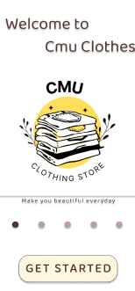
Online Clothing Retail application
SRS DOCUMENT
Date: September, 2024
CMU-SE 214 ACIS
Online Clothing Retail application
International School
Posted by
Nguyen Phan Vinh Le Tien Danh Tran Anh Quang Huynh Tan An Thai Thanh Cong Le Hai Dang
Approved by
Nguyen Trung Thuan

Slide 2
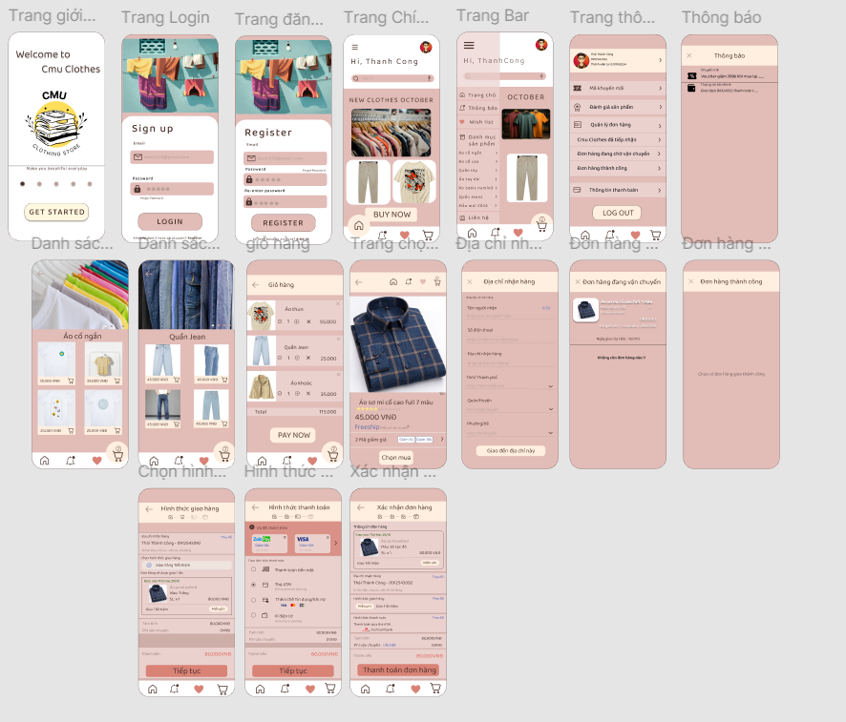
I.Introduce
1.Document purpose
Online Clothing Retail application. It will explain the purpose and characteristics of the system, its interfaces, the functions the system will perform, the constraints it must adhere to, and how the system will react to external stimuli. This application aims to create a convenient, fast, and secure shopping experience for users while connecting consumers with fashion brands through an online platform.

Slide 3
2.Scope
This online clothing retail application is designed to serve a diverse audience and functions, creating a wide range of options:
Customers and Users: The application primarily targets individuals who are interested in fashion and shopping online. However, it can also cater to a broad audience, including various age groups and fashion preferences.
Range of Products: The application offers a wide variety of clothing items, including apparel for men, women, and children, as well as accessories. This ensures that users can find suitable options for themselves and their loved ones.
Accessibility: The application is accessible from anywhere with an internet connection (3G, 4G, 5G, Wi-Fi), making it easy and convenient for users to shop from personal computers, mobile phones, or tablets.

Slide 4
3.Project Proposal
Technology today is one of the most important resources and can be applied in all areas of life, from science, education, engineering, and communication to entertainment, shopping, and many other fields. Therefore, the idea is to create an online clothing retail application to help people easily access fashion and shopping. The online clothing retail application is a software system designed to support fashion shopping activities. This application simplifies the shopping process, increases accuracy and efficiency, and improves the user experience. The online clothing retail system includes features such as browsing and searching for products, order tracking, promotional notifications, product reviews, and flexible payment integration. The application also allows users to store their account information and shopping history. Thus, the Online Clothing Retail Application is a great solution that helps users save time and effort in shopping while meeting their fashion needs quickly and conveniently.

Slide 5
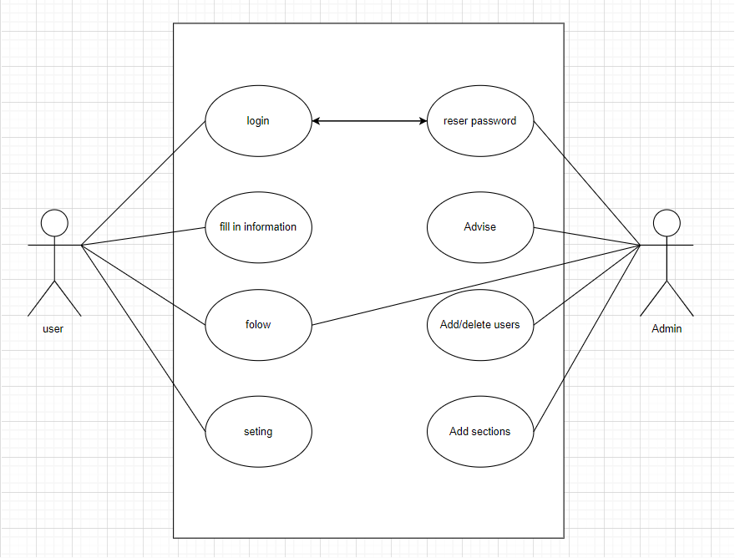
II.Overall Description
The system environment refers to the overall context in which a system operates. It consists of a number of
Software: Includes operating systems, applications, and tools running on the hardware.
Hardware: Physical
Configuration: s
Data: Information
Users: Indian
Understanding the system environment is crucial for effective system management, performance optimization, and security measures. It helps ensure that all components work in harmony
Use Case Diagram

Slide 6
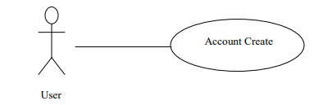
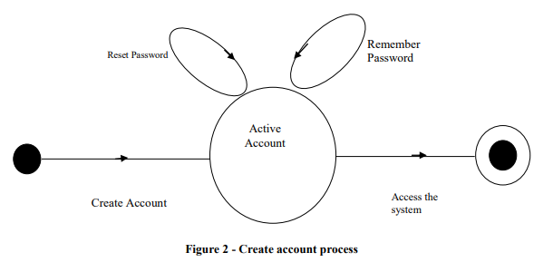
Functional Requirements Specification
This section outlines the use cases for each of the activities in the program.
Register users Use Case
Use case: Account Create
Brief Description
If the user wants to use the program, he must register within it to benefit from it.
Initial Step-By-Step Description
Before this use case can be initiated, the user already has the program.
1. The user will be creating an account.
2. The system requires the activation of the account.
3. The user needs to reset the password.
4. User access the system.

Slide 7
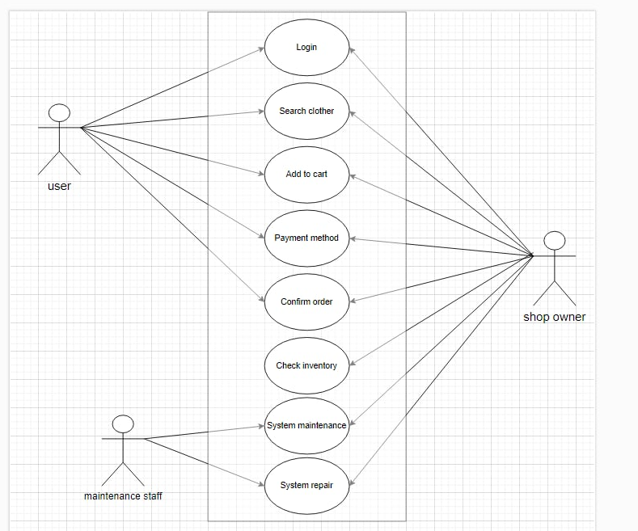
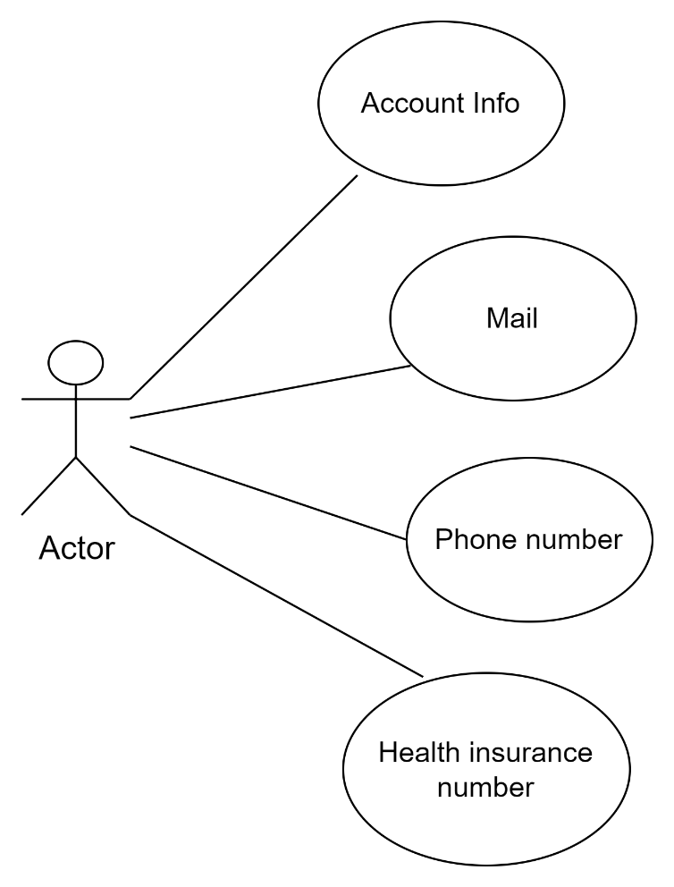
User Use Case
The User after registering has the following:
Use Case

Slide 8
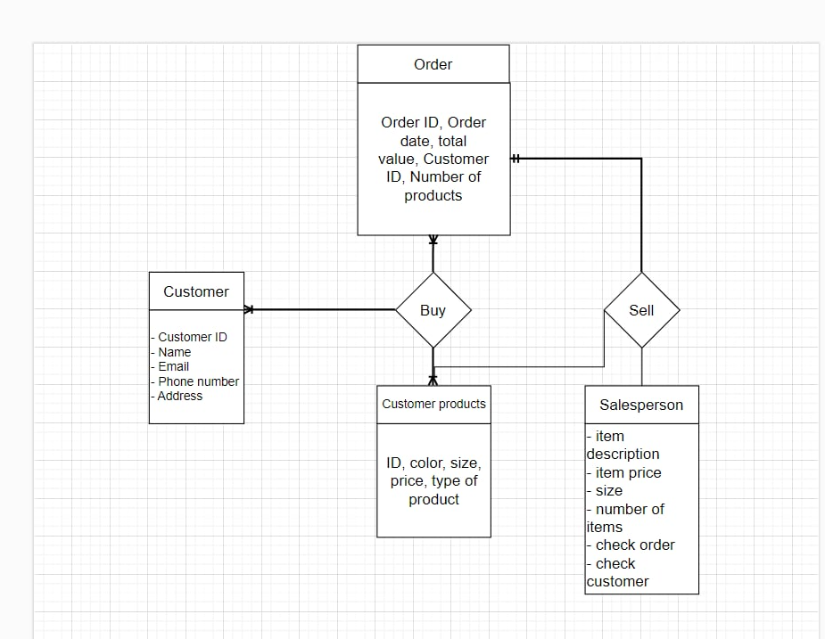
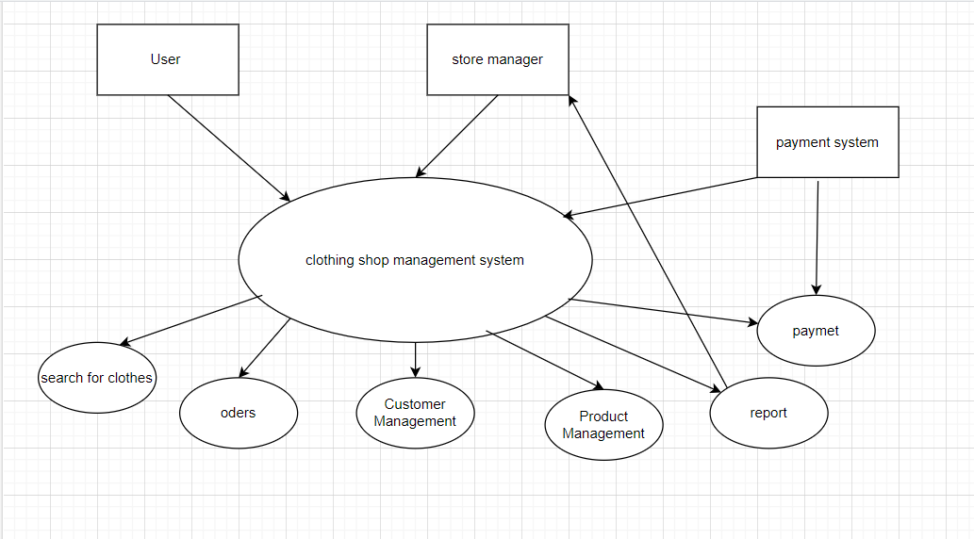
Help ER Diagram

Slide 9
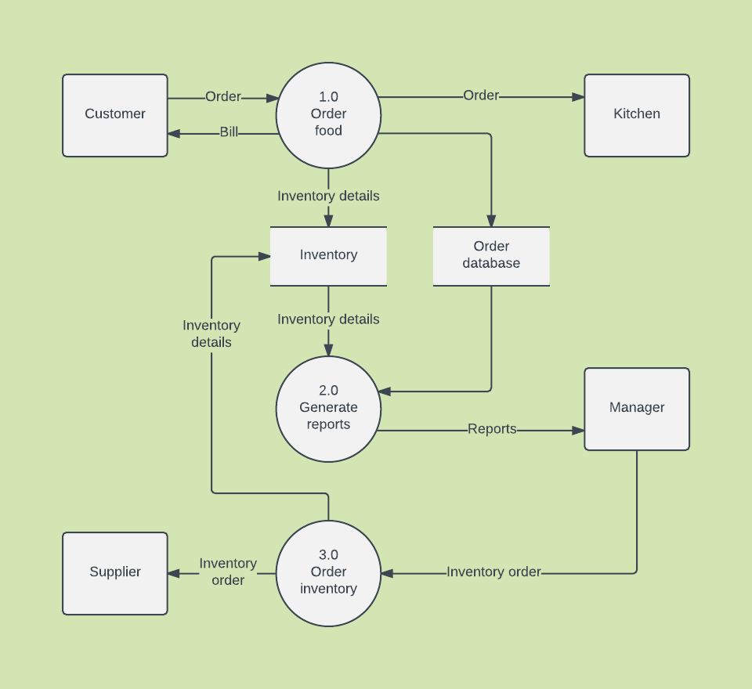
System Work Data Flow Diagram
Functional Requirements for a Clothing Store:
1. Product Browsing and Search
2. Product Detail Page
3. User Registration and Login
4. Shopping Cart Management
5. Checkout Process
6. Order Tracking
7. Inventory Management
8. Product Reviews and Ratings
9. Shipping Options
10. Mobile Responsive
11. Secure Payment Gateway
12. Social Media Integration

Slide 10
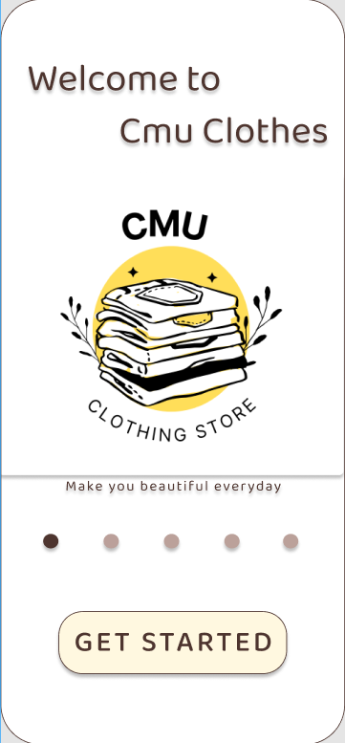
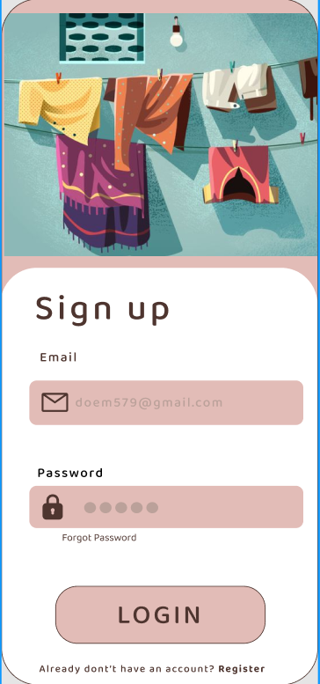
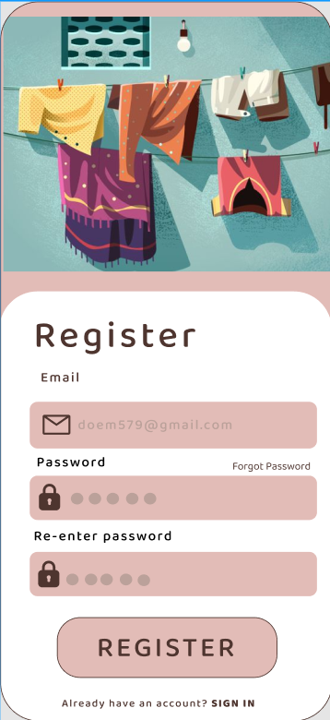
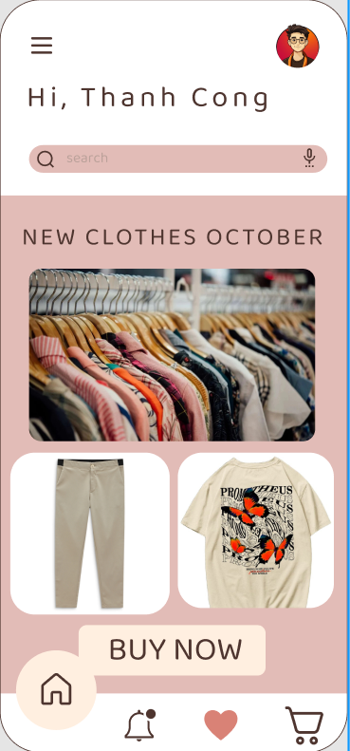
Layout

Slide 11
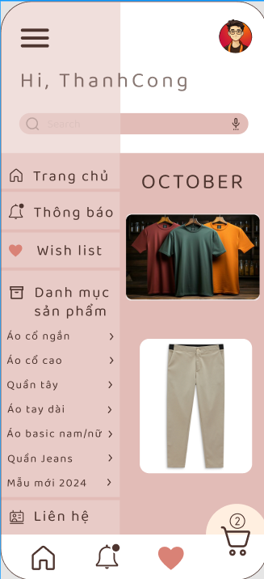
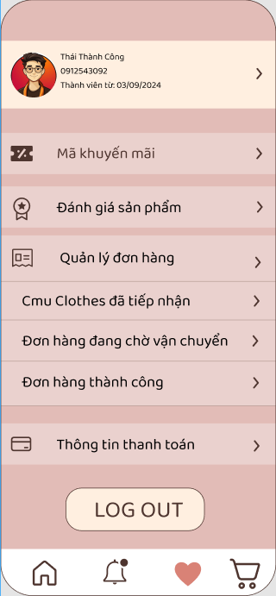
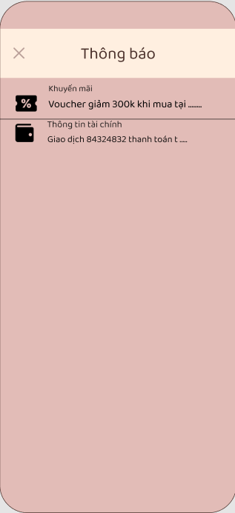
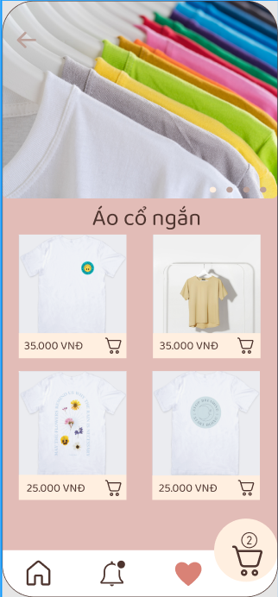
Layout

Slide 12
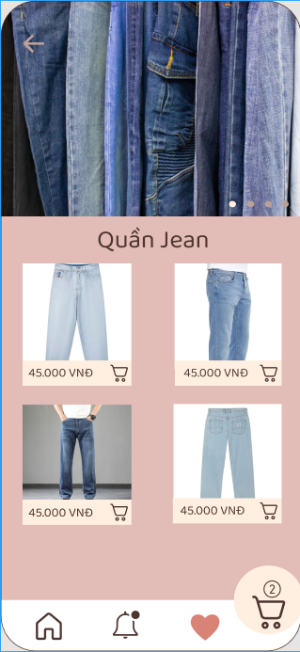
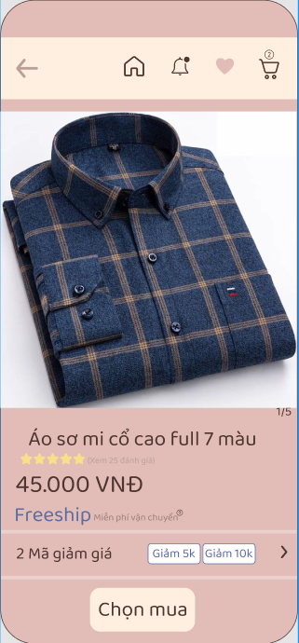
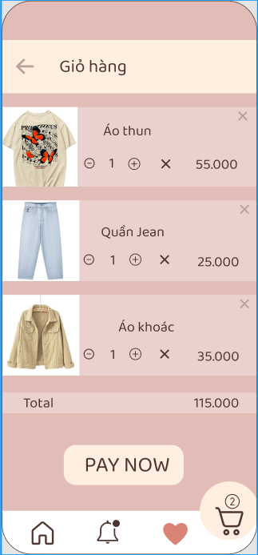
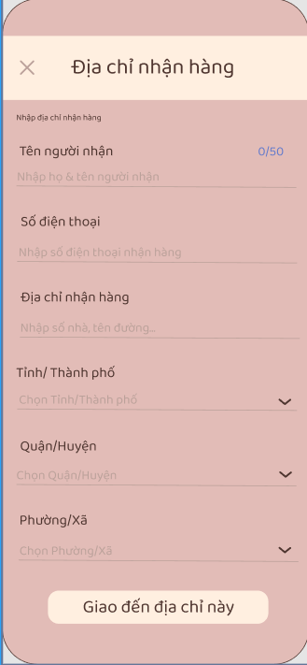
Layout

Slide 13
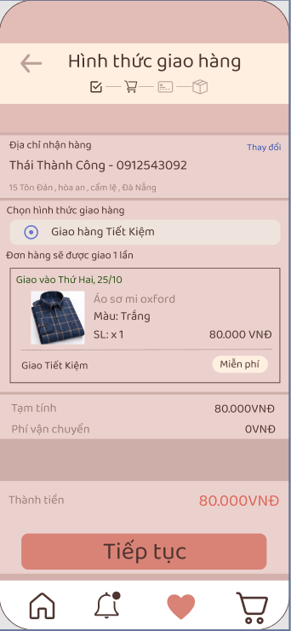
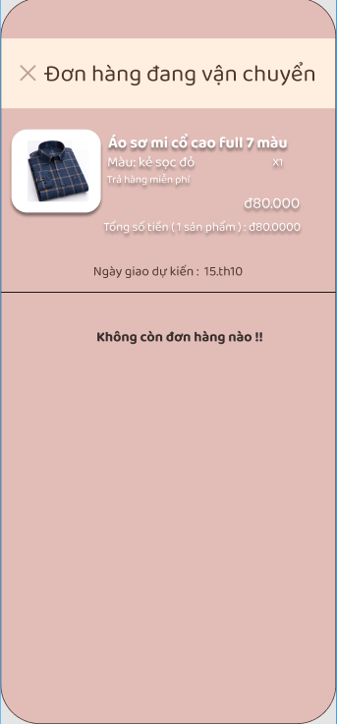
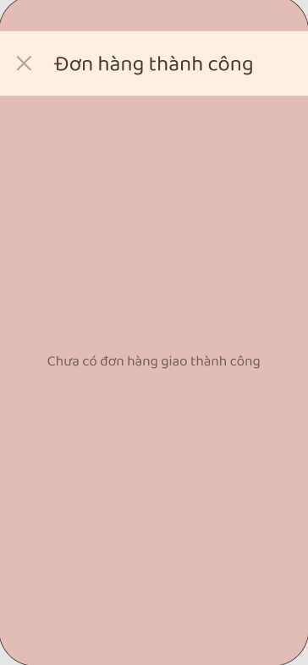
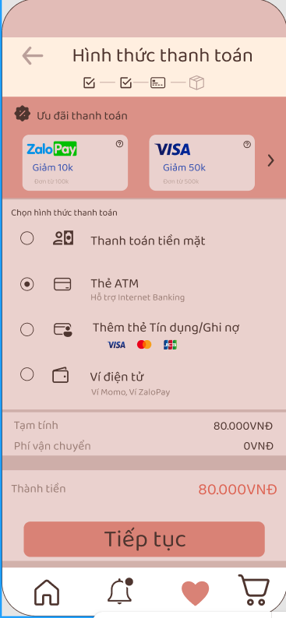
Layout

Slide 14
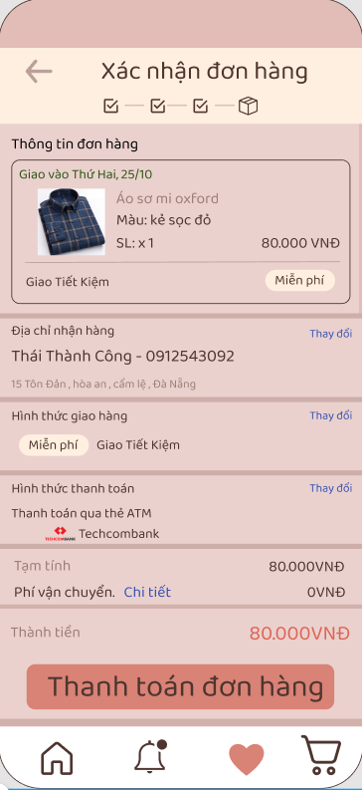
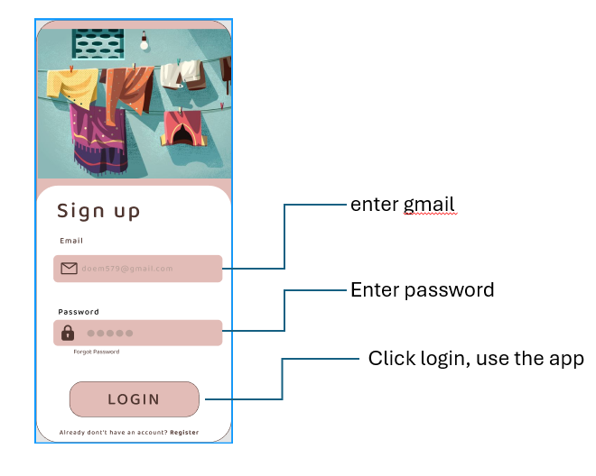
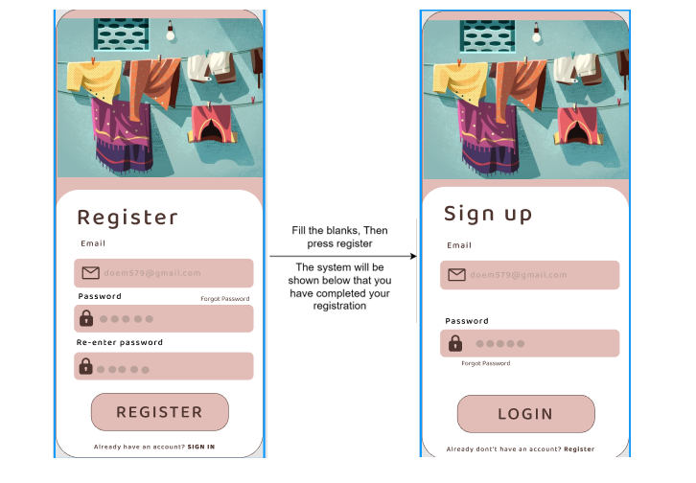
Layout

Slide 15



Technologies used

Slide 16





To Used TTool Used ManageTool
Google Drive
Figma
Trello
Github
Zalo

